Slide 1
Fake News Detection Using BERT Model Team Members: Abhishek Chaudhary THA076BCT003 Adhip Bhattarai THA076BCT004 Kshitiz Poudel THA076BCT018 Nandan Singh THA076BCT020 Department Of Electronics and Computer Engineering Institute of Engineering, Thapathali Campus 3rd Feb, 2023

Slide 2
Presentation Outline
Motivation
Project Objectives
Project Scope
Project Applications
Methodology
Results
Analysis / Discussion of Results
Remaining Tasks
References

Slide 3
Motivation
Increase of fake news in social media
Use of fake news for political gain in Election of Nepal

Slide 4
Project Objectives
To classify /distinguish real and fake news from Nepali text
To implement the system into use on the web and make it broadly accessible.

Slide 5
Project Scopes
Nepali-text based fake news detector
Design of web app
Use of translated fake news from English fake news data
Trained on only 6321 true and fake news data, so less accuracy

Slide 6
Project Application
Media and Journalism
Political campaign
Business

Slide 7
Methodology
BERT model
Transformer based architecture
Stack of 12 encoder layers
Each encoder layer has multi-head attention and feed-forward network
Input tokens are embedded with positional embeddings
Self attention layer converts embeddings to attention vectors
Feed-forward network convert attention vector suitable for next layer
Final encoder layer outputs sequence outputs

Slide 8
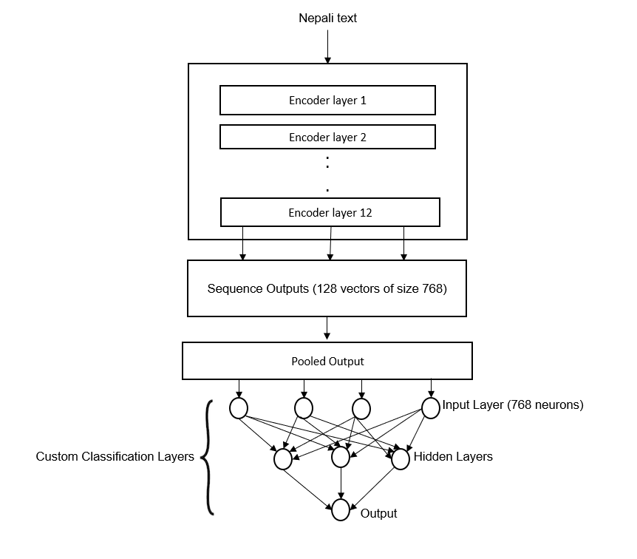
Methodology
Fig: System Architecture

Slide 9
Methodology
Data Collection:
Real news scraped from Nepali online news sites (3432)
Fake news (2889)
Translation from English to Nepali (obtained from Kaggle)
Data Pre-processing:
Label data: Real – 0, fake – 1
Remove null values, unnecessary columns, punctuations, stop words
Perform stemming and generate stemmed text

Slide 10
Methodology
Test-train split
Split the dataset into train and test in the ratio 8:2.
Tokenization
Use BERT tokenizer for tokenizing all the words

Slide 11
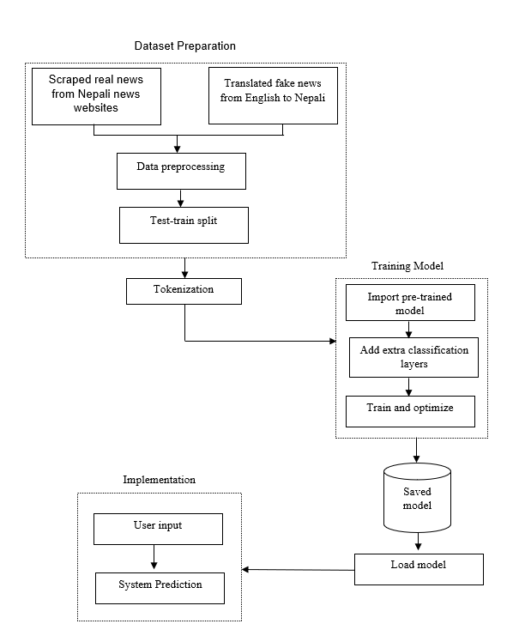
Methodology
Fig: Block Diagram

Slide 12
Methodology
Define Model Architecture
Consists of BERT with classification layers
Defined loss function and optimizer
Loss function used – Binary cross-entropy
Optimizer Used – Adam
Training BERT model
Import pre-trained “bert-multilingual-uncased” model
Adding additional neural network for classification
Training and fine tuning BERT model

Slide 13
Methodology
Performance metrics evaluation
Deploy Model
Created Website
Frontend – HTML, CSS
Backend – Flask

Slide 14
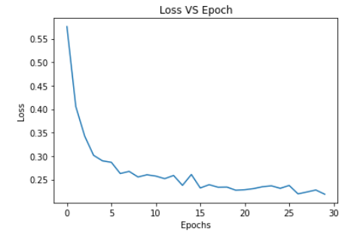
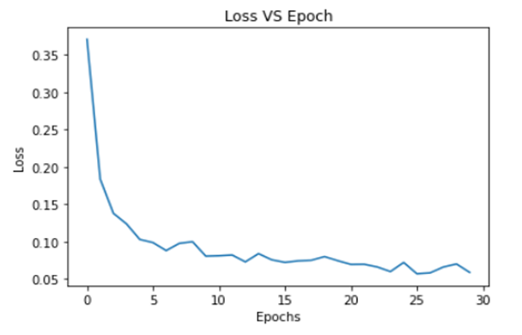
Results
Loss vs Epoch Graph
Fig: For Stemmed Data
Fig: For Non-stemmed Data

Slide 15
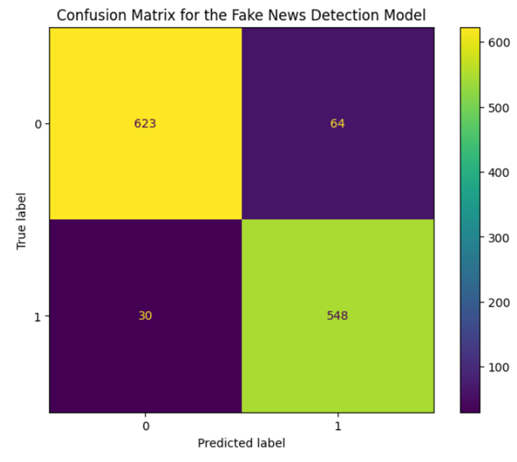
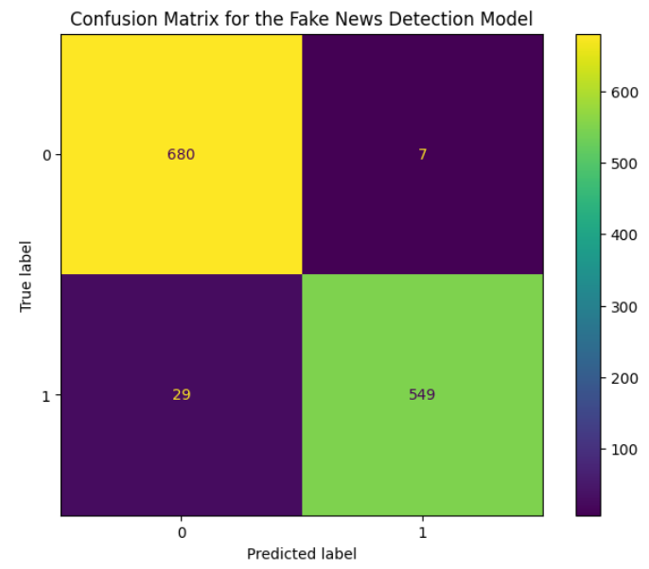
Results
Confusion Matrix
Fig: For Stemmed Data
Fig: For Non-stemmed Data

Slide 16
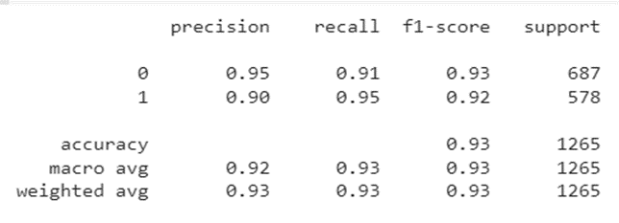
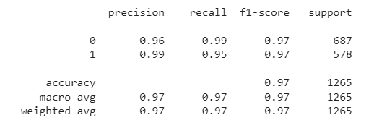
Results
Evaluation Metrics
Fig: For Stemmed Data
Fig: For Non-stemmed Data

Slide 17
Analysis/ Discussion of Results
Hyperparameters used:
Learning rate = 1e-3
Epoch = 30
Batch size = 32
From loss vs epoch graph, we found:
Loss of Non-stemmed = 0.03
Loss of stemmed = 0.07

Slide 18
Analysis/ Discussion of Results
From Confusion Matrix
Stemmed data gives more false positive and false negatives
Non-stemmed data performed better

Slide 19
Analysis/ Discussion of Results
From both evaluation metrics,
Precision, f1-score, accuracy is better for non-stemmed data

Slide 20
Remaining Tasks
Train on larger dataset
Web implementation

Slide 21
References
[1] C. Elliott, "forbes," 21 February 2019. [Online]. Available: https://www.forbes.com/sites/christopherelliott/2019/02/21/these-are-the-real-fake-news-sites/?sh=2554c7c23c3e.
[2] D. Adhikari, "Onlinekhabar," 13 December 2022. [Online]. Available: https://english.onlinekhabar.com/misinformation-elections-nepal.html.
[3] A. C. Leo Breiman, Random Forests, 2001.
[4] M.-W. C. K. L. K. T. Jacob Devlin, "BERT: Pre-training of Deep Bidirectional Transformers for Language Understanding," Google AI Language, 2019.
[5] K. Stahl, "Fake news detection in social media," 2018.
[6] B. D. P. S. Y. Jiawei Zhang, "FAKEDETECTOR: Effective Fake News Detection," 2019.
[7] S. R. M. K. S. Gowthami. K, "Identification of Fake News through SVM and Random Forest," 2020.

Slide 22
References
[8] S. K. S. P. R. V. S. P. Tejaswini Yesugade, "Fake News Detection using LSTM," International Research Journal of Engineering and Technology (IRJET), 2021.
[9] S. S. S. M. P. Uma Sharma, "Fake News Detection using Machine Learning Algorithms," International Journal of Engineering Research & Technology (IJERT), 2021.
[10] I. B. D. M. S. A. I. Kadek Sastrawan, "Detection of fake news using deep learning CNN–RNN based methods," 2021.
[11] V. R. H. V. Mahmood Farokhian, "Fake news detection using parallel BERT deep neural networks," 2022.
[12] S. P. P. T. B. T. Shiva Ram Dam, "Detecting Clickbaits on Nepali News using SVM and RF," 2021.
[13] "Tensorflow," [Online]. Available: https://www.tensorflow.org/text/tutorials/bert_glue.

